Slide 1
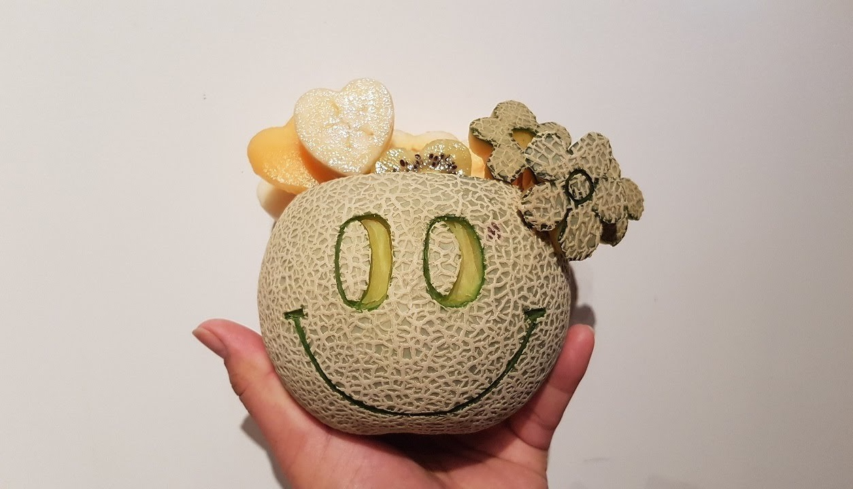
Crispy Cantaloupes
Sprint- 2

Slide 2
Design Highlights
Spark and Ajax routes follow design principles
Information hiding and information expert fully implemented throughout the project: data and functionality properly assigned to classes
No inheritance: expect for spark routes, because we didn’t feel the need for inheritance
Single Responsibility: We made sure single modules or classes have single part or single functionality.
There is high cohesion but we still have room to improve on low coupling starting with our move validator class which has too many dependencies.

Slide 3
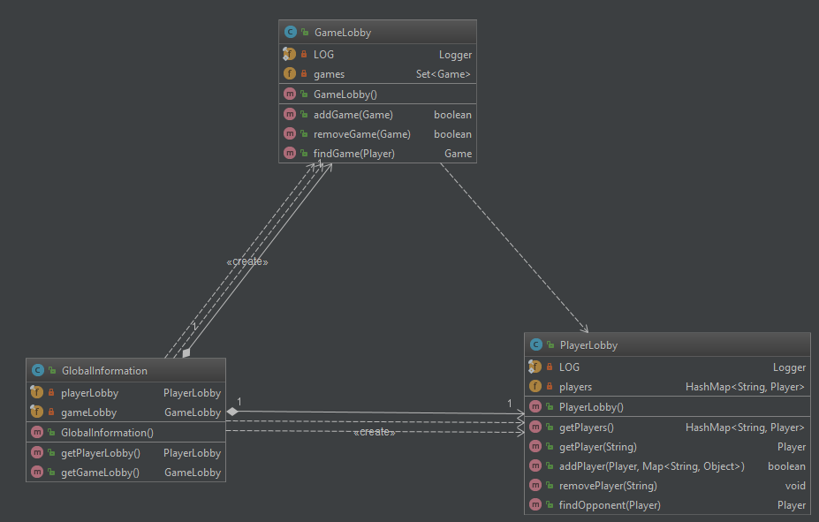
Controller principle implemented in PlayerLobby and GameLobby classes and pure fabrication implemented in the routesAndKeys class
Overall improved design from sprint 1, we spent a fair amount of time refactoring code and have established a good foundation for future development.

Slide 4
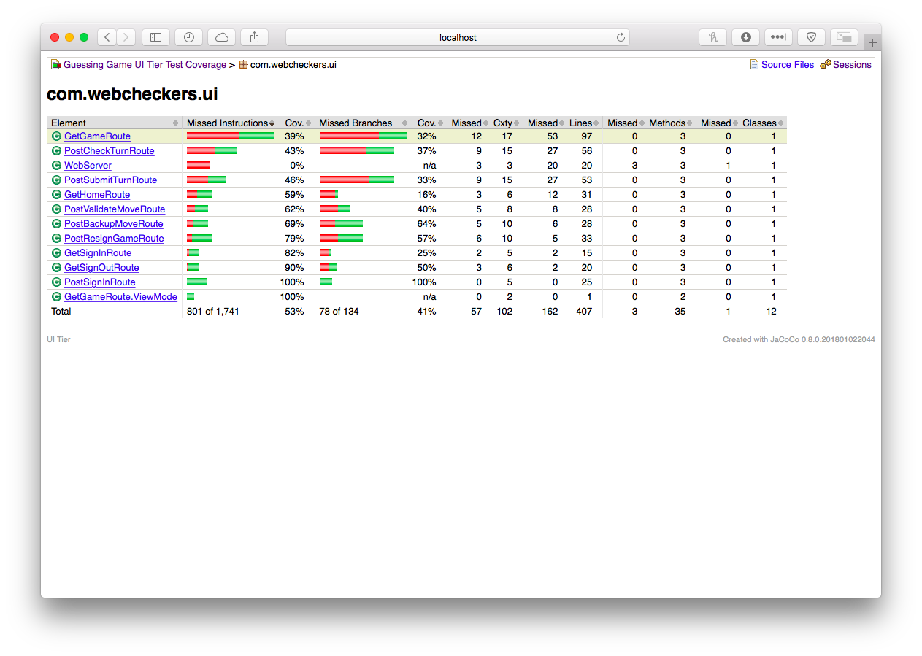
Code Coverage

Slide 5
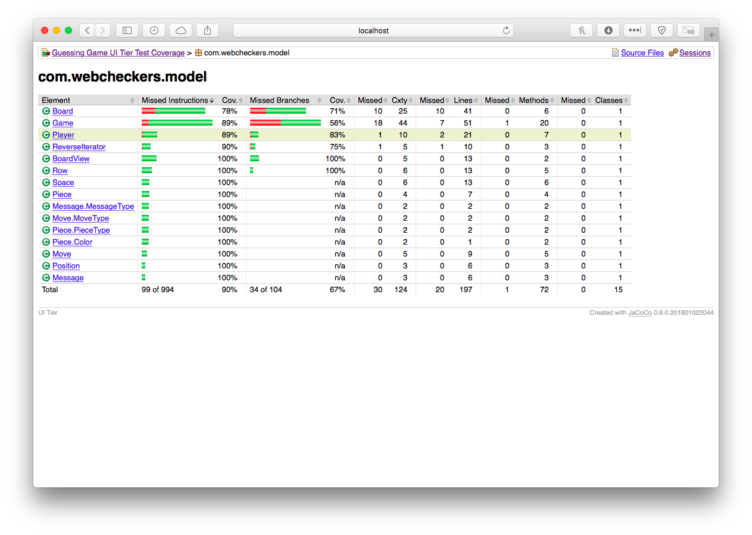
Model Tier Code Coverage

Slide 6
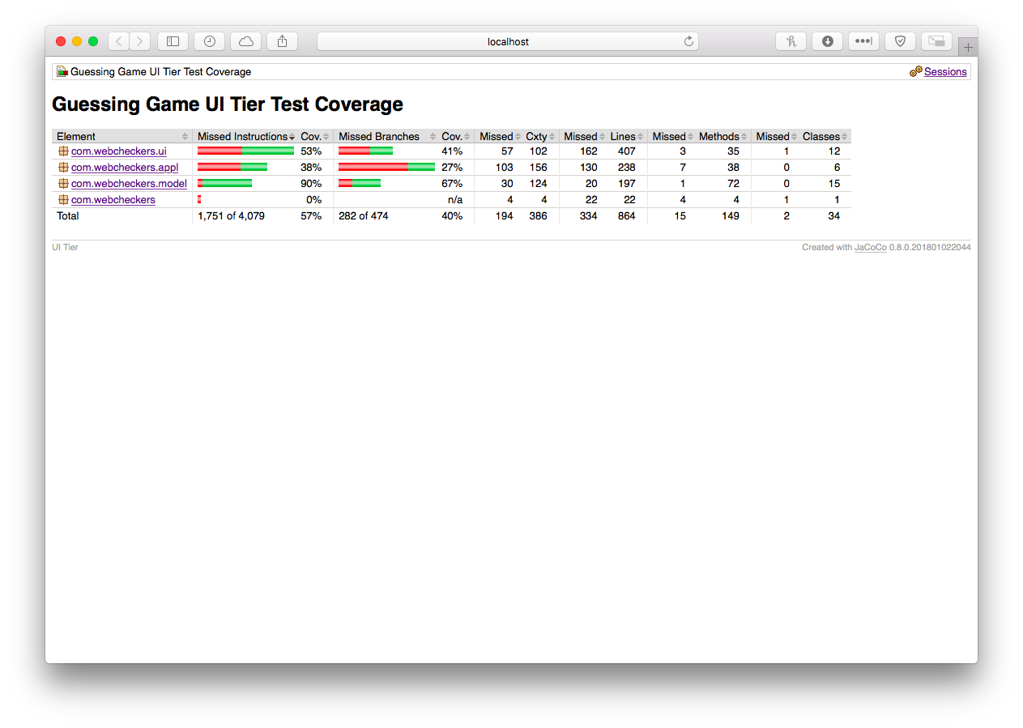
UI Tier Code Coverage

Slide 7
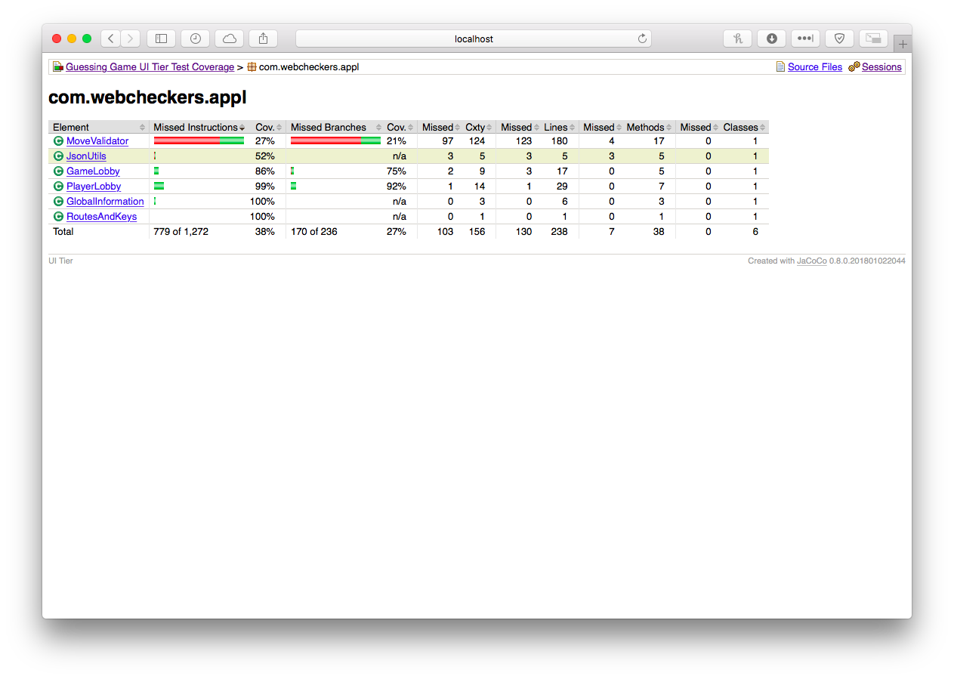
Application Tier Code Coverage

Slide 8
Trello
https://trello.com/b/HYk4rzx8/webcheckers-project-team-c-crispycantaloupes

Slide 9
Code line (GitHub)
https://github.com/RIT-SWEN-261-01/team-project-2175-swen-261-03-c-crispycantaloupes/network

Slide 10

Team performance: Norming out the kinks
We believe that we have come much
further from where we initially began
and now are able to problem solve
and find a way to complement each other rather
than counteract each other’s decisions. We have established a smooth road
of understanding and acceptance of the team dynamics and know how
to work around the kinks.

Slide 11
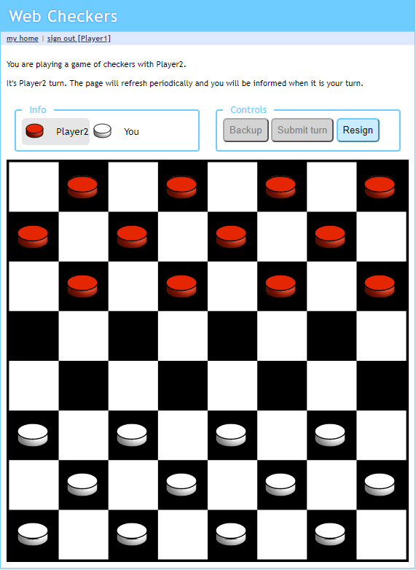
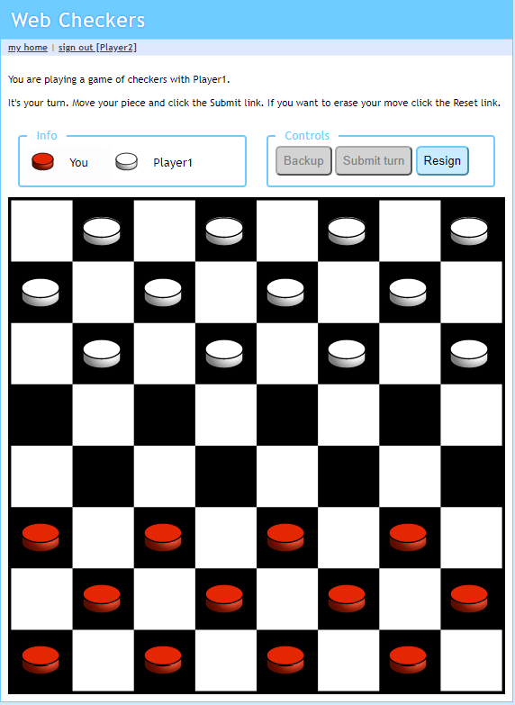
Making a simple move, on this piece

Slide 12
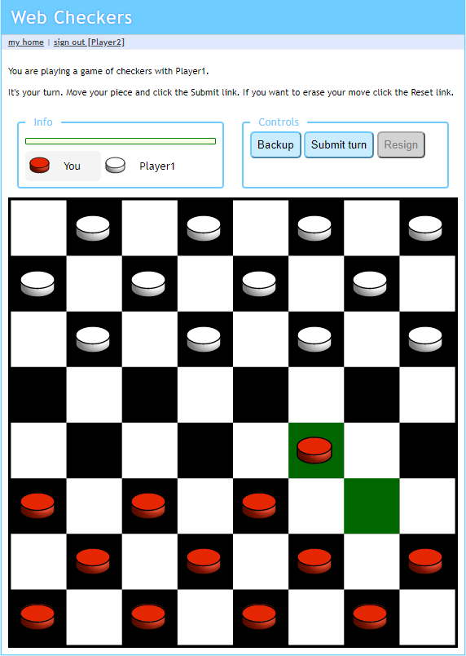
When you hit the submit button

Slide 13
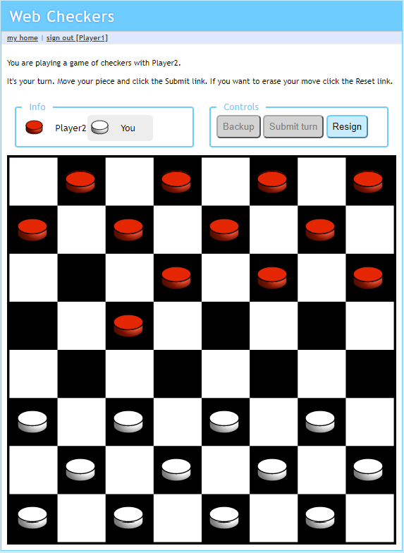
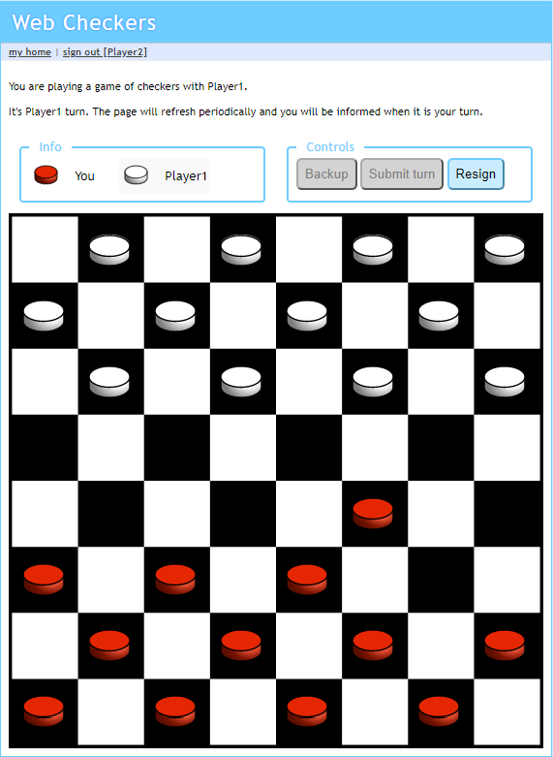
Player 2’s board gets updated

Slide 14
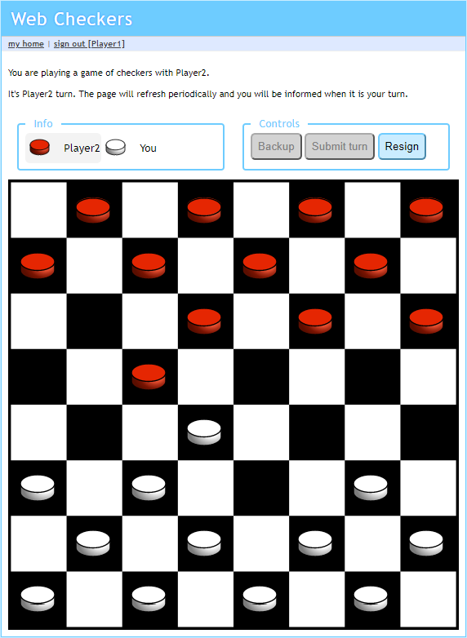
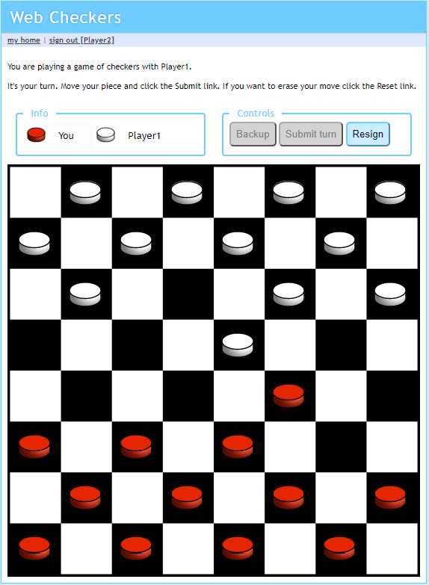
Let’s demonstrate a simple jump using this piece

Slide 15
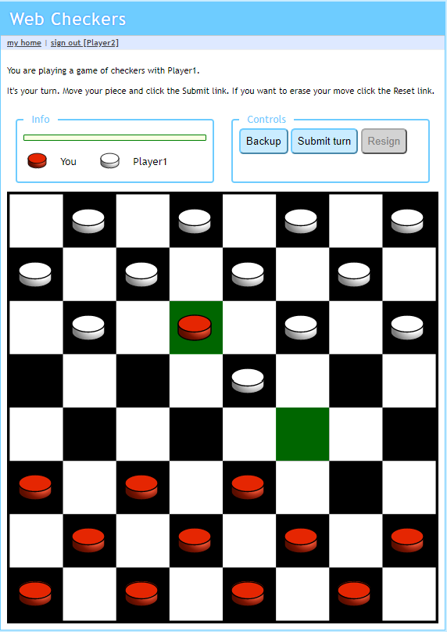
When you hit the submit button

Slide 16
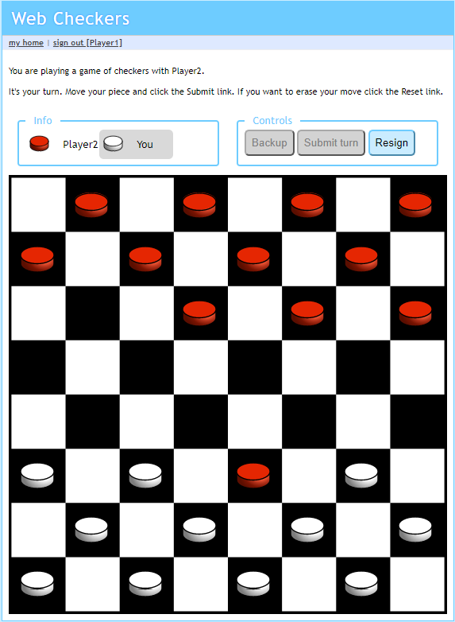
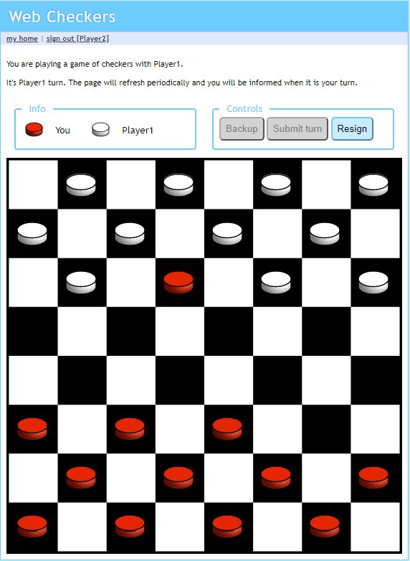
Player 2’s board gets updated

Slide 17
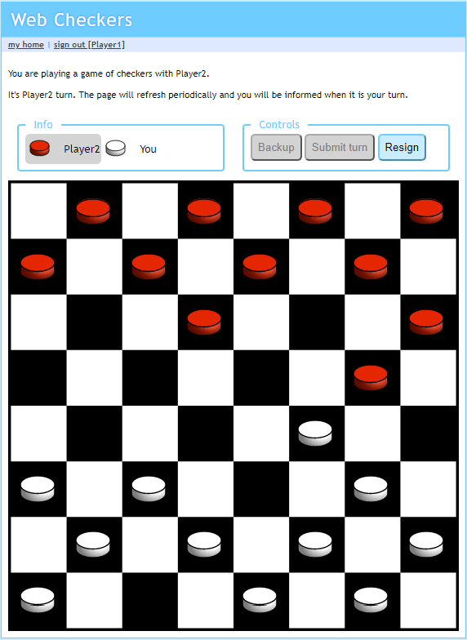
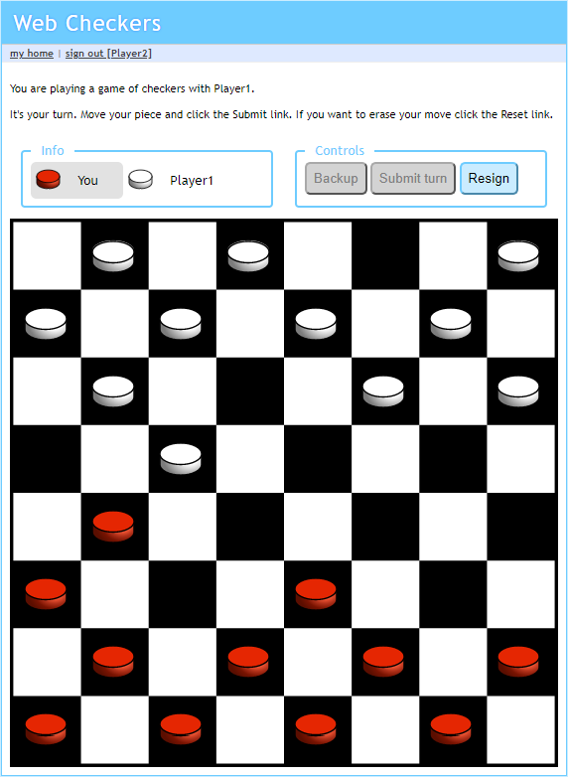
Initial Board setup, demonstrating multiple jump
Let’s take the first jump, watch this piece

Slide 18
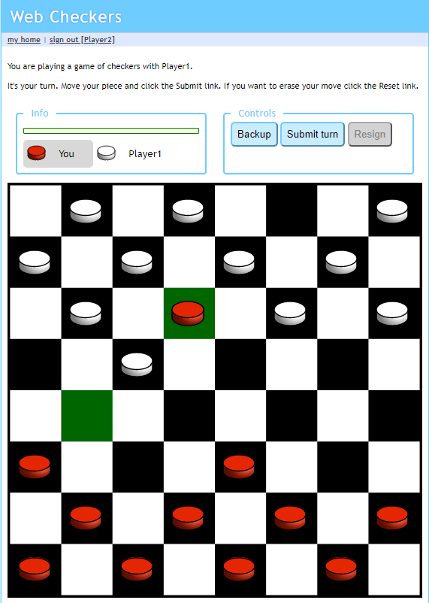
Making the second jump with the same piece

Slide 19
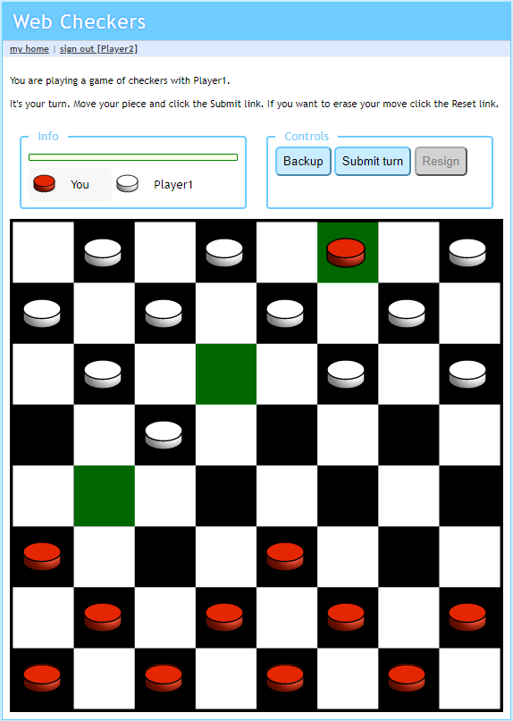
When you press submit

Slide 20
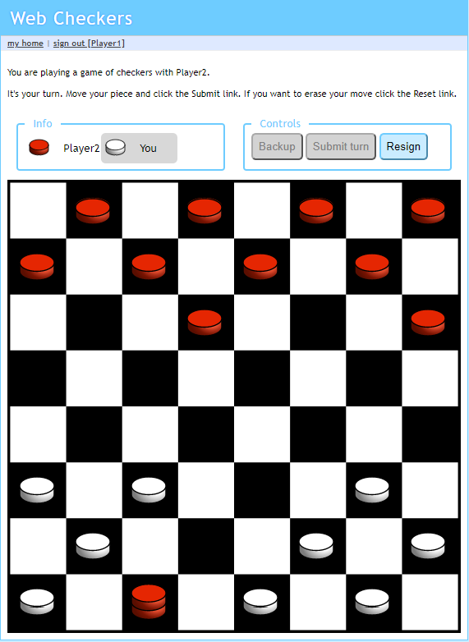
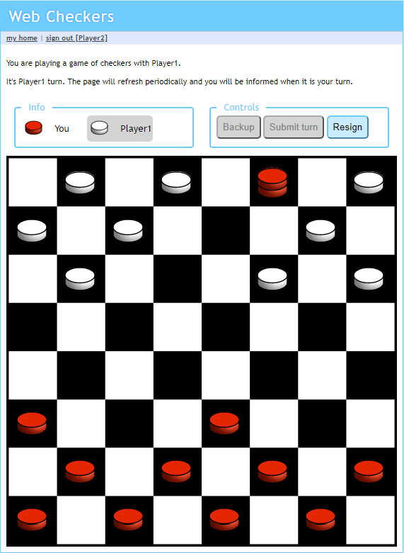
Piece gets upgraded to king
Player 2’s board gets updated as well

Slide 21
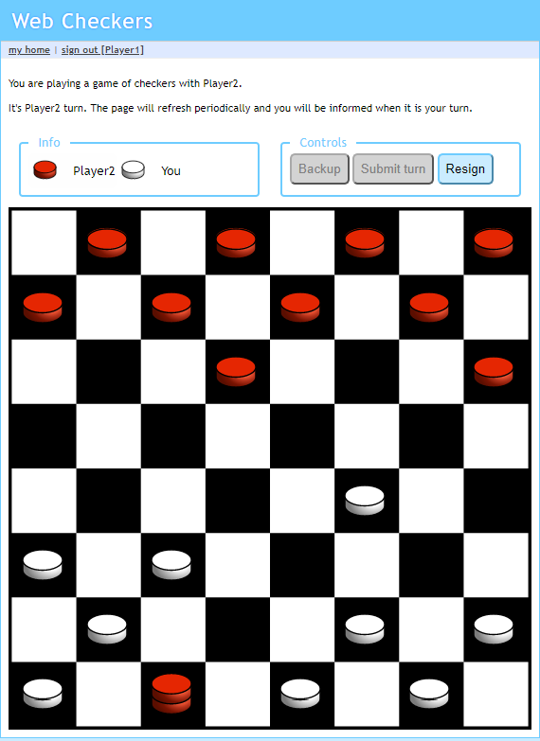
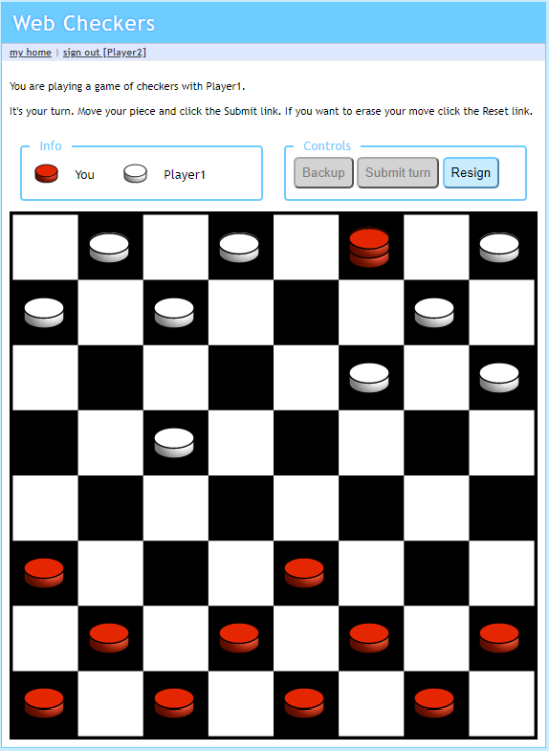
Let’s make a single king move

Slide 22
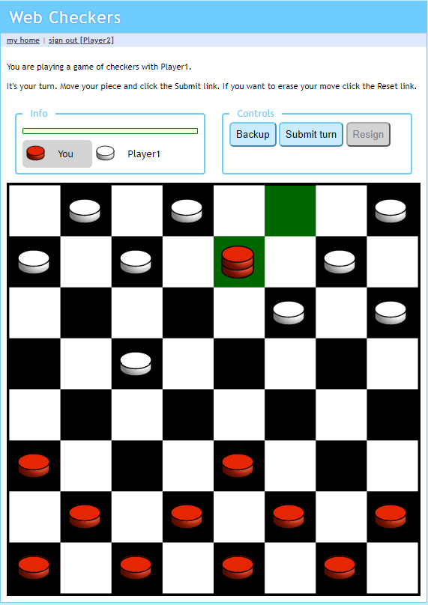
Wait! Let’s undo that move

Slide 23
Now, let’s actually do a simple king move

Slide 24
When you hit the submit button

Slide 25
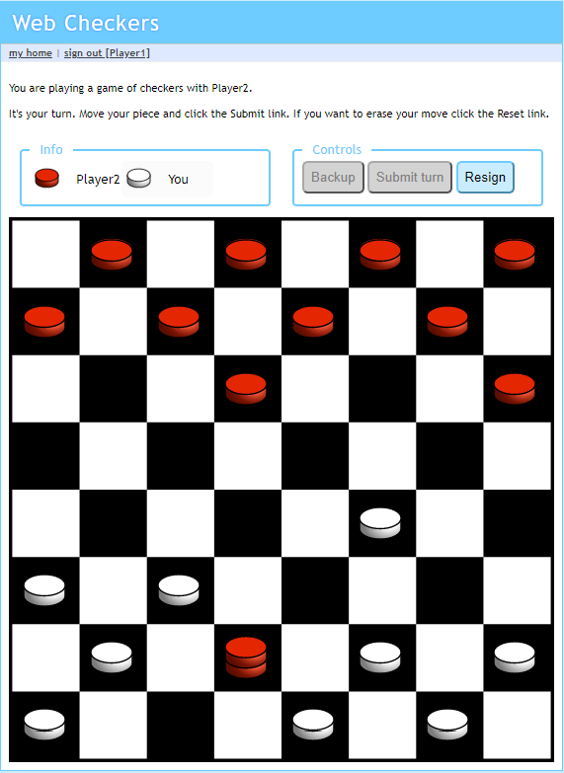
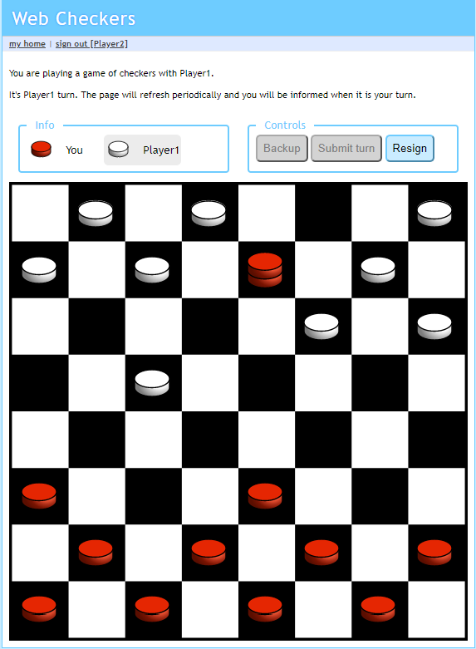

Slide 26
Future Plans
Debug kingJumpMoves
Enhancements
Player Help: A player is able to request in game help.
Replay Mode: Games can be stored and then replayed at a later date.

